Slide 1
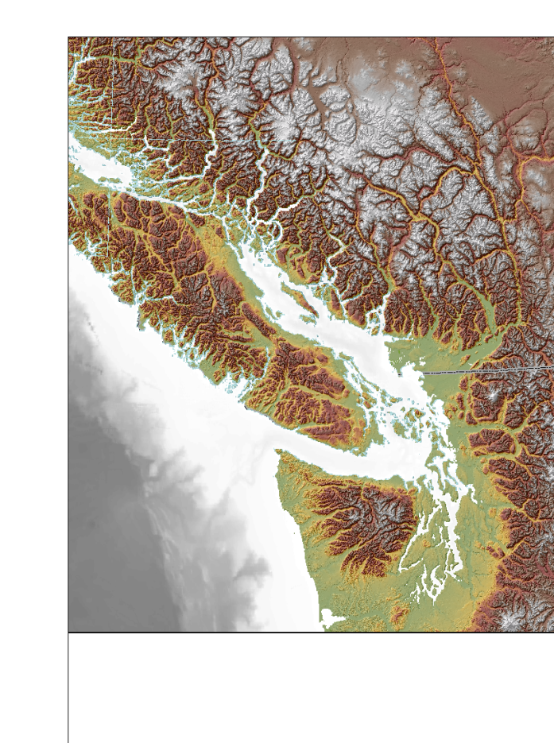

Salish Sea Ambient Monitoring Exchange (Ssamex)
The Salish Sea Ambient Monitoring Exchange (SSamex) will harmonize existing marine monitoring in Canada and USA and provide a data-sharing platform. Focus will be on;
The Salish Sea
Fill data gaps and Establish baselines for habitat and biotic conditions in the Salish Sea
time-trends in marine environment and biota due to changing background conditions
Promote trans-boundary collaboration in quality, methodology and sampling parameters for cohesive data sharing
Provide context for regulators to evaluate ecological significance of discharges of concern
  Collaborative monitoring, research and data sharing
The program will build upon existing monitoring programs, with common quality control, new measurements and sampling locations to fill spatial gaps . A critical component is an on-line data-sharing platform. The data to be included will be selected to reflect the goals and questions of focus for the program, rather than a general data archive. The Program will house and support specific research initiatives focused on important issues and gaps in understanding expressed by the collaborators. A high level analysis and regular reporting of the data collected will be shared among Ssamex participants. Some of these high level data summaries will form the basis of ocean health indices.
The opportunity
Ssamex follows a 10-year collaborative research program in BC focused on understanding particulates, organics and contaminant cycling and budgets throughout the Strait of Georgia, with the ultimate goal of defining long-term ambient monitoring to place effects from anthropogenic stressors into context with oceanic shifts (climate) and predict critical tipping points for local effects. This highlighted the need for an initiative involving the entire Salish Sea. Partners in Canada and the USA can contribute by a) collecting and analysing monitoring data for sharing with other participants, b) in-kind monitoring support for other member organizations through directed sampling, ship time, field personnel, sample analyses, and c) direct monetary support.

Slide 2
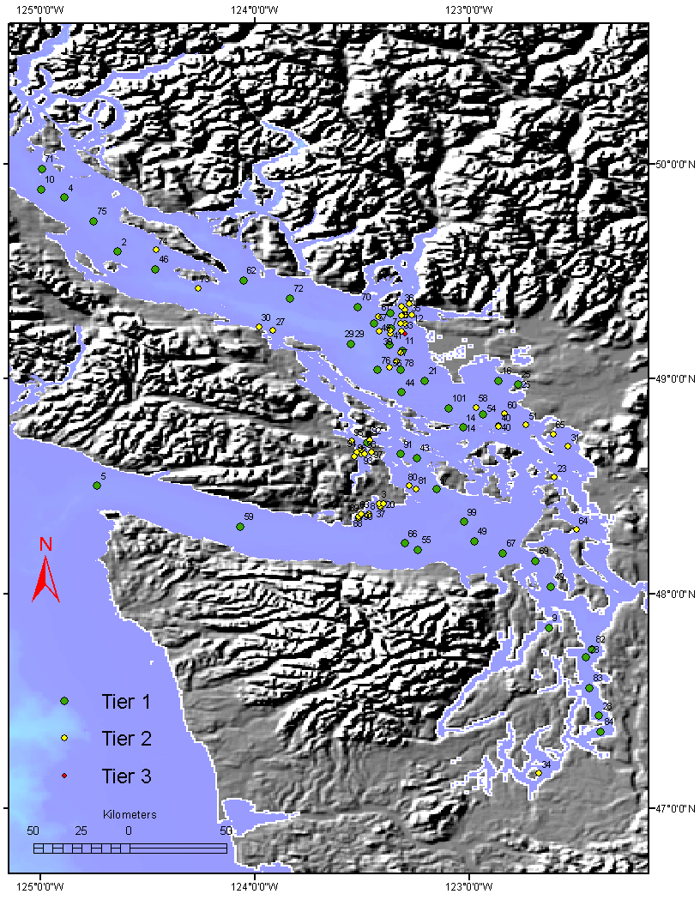
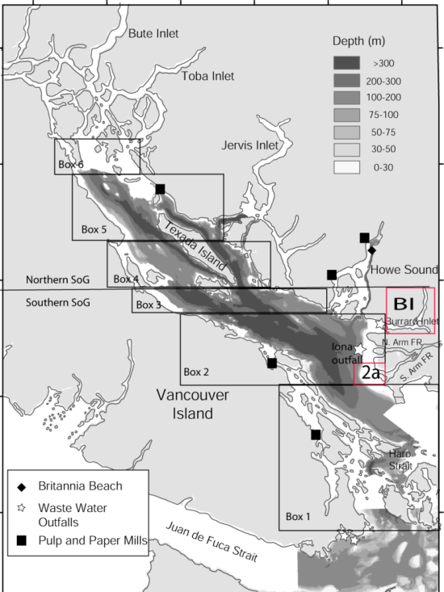
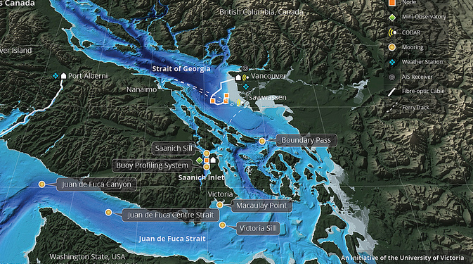
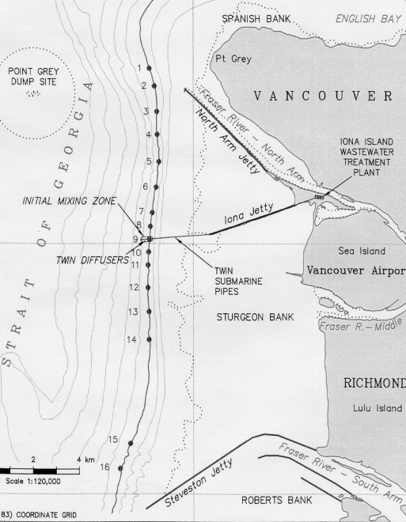
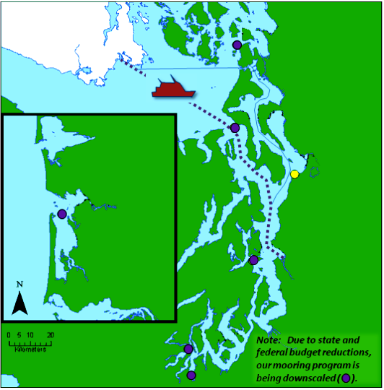
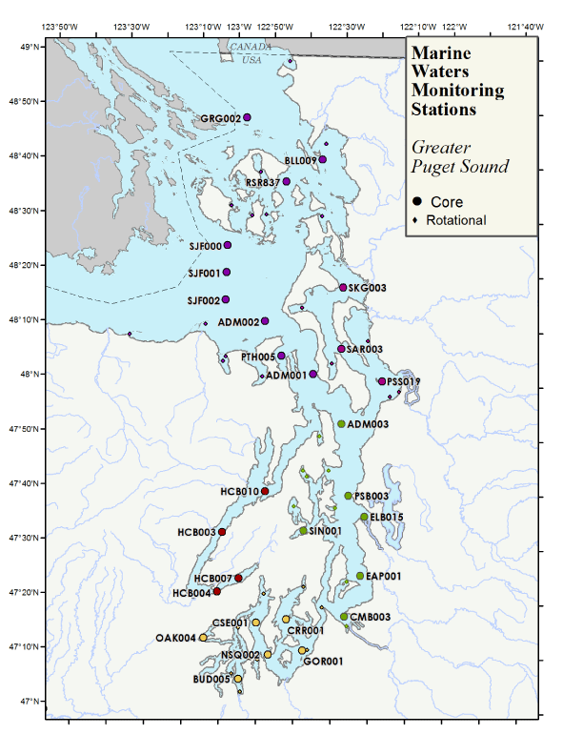
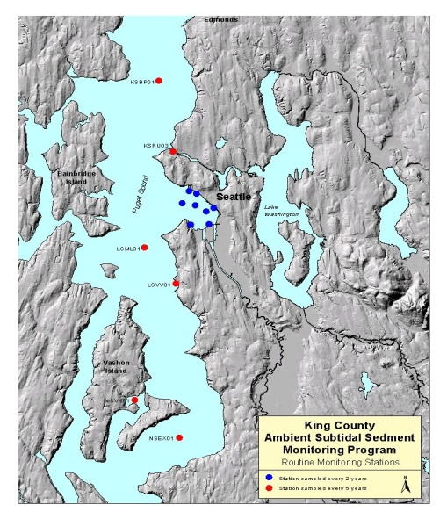
Example Ssamex Partners
Ocean Networks
Canada
Strait of Georgia
Ambient Program
Victoria
CRD
Metro Vancouver
Washington
State Ecology
King County

